Slide 1
ENGR 12
Dr. Mandala
Notes:
Down

Slide 2

First year conference

Slide 3
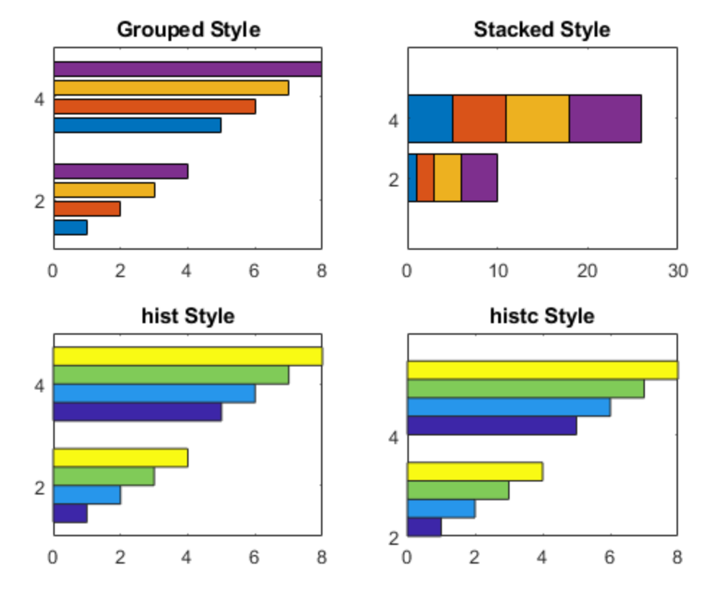
Histograms (Section 4.12.7)

Slide 4
Basic steps
Calculate RANGE of data (MAX-MIN)
Divide this RANGE into adjacent bins (equal spaced intervals)
Count the upper and lower bounds of bins
Count data points in each bin
Note: Data belongs to a bin if its equal to or greater than lower bound AND lesser than upper bound.
Plot the number of data points in each bin as bar chart

Slide 5
BAR Command
Creates a vertical bar-plot
MATLAB Command: bar(x,y,style)
x is an array defining x-values
y is an array defining y-values
style=‘grouped’,’stacked’,’hist’,’histc’ and is optional
To create Histogram
x = array containing bin left bound
y = array containing frequency count of data per bin
Notes:
grades=[71,58,75,90,82,89,85,94,90,81,97,94,93,...
65,48,62,80,85,90,86,85,78,79,60,89];

Slide 6
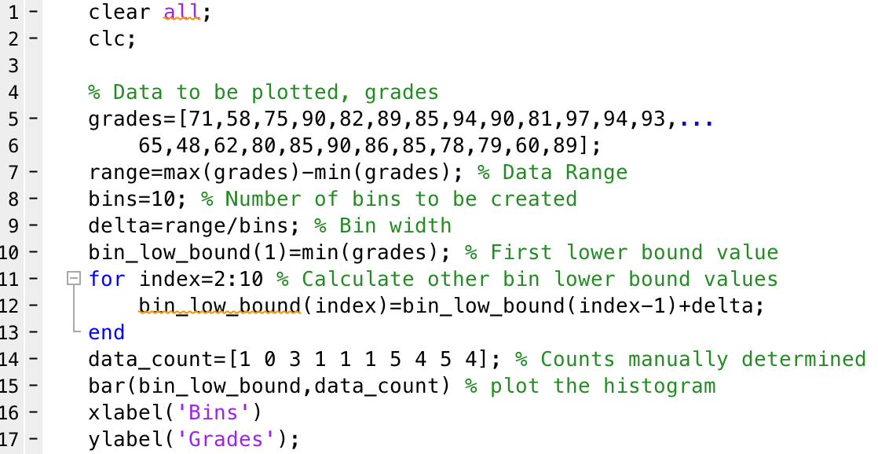
Sample code: Histogram manual
Notes:
grades=[71,58,75,90,82,89,85,94,90,81,97,94,93,...
65,48,62,80,85,90,86,85,78,79,60,89];

Slide 7
Using Hist and Histc
hist and histc can calculate the bin frequency automatically
histc requires data array and edge array (bin lower bound) as input argument
ncount = histc(grades,bin_low_bound)
[ncount,bincount]=histc(grades,bin_low_bound)
Note: edge array should contain upper bound as the last value
hist requires data array and number of bins as input arguments
ncount = hist(grades,10)
[ncount, bin_low_bound]=hist(grades,10)
Note: number of bins is option, and default is 10.

Slide 8
Histograms
You can use, hist, histc, or histogram commands to create histograms automatically
Example: >> histogram(grades,10)
MATLAB recommends using histogram and histcounts
Newer features
Output of the function creates an object (structured data type)
>> N = histogram(grades,10);
>> N.Values would contain the Bin counts
Notes:
dia=[1,1.25,1.5,2,2.5,3,3.5,4,5,6,8];
mass=[1.68,2.27,2.72,3.65,5.79,7.58,9.11,10.79,14.62,18.97,28.55];

Slide 9
Plots (section 4.13.1)
Engineers frequently plot either a measured or calculated dependent variable, say y, versus an independent variable, say x. A simple y versus x plot is obtained with the command plot(x,y)
x=[0, 1, 2, 3, 4, 5, 6 ,7 ,8]; % independent values
y=[0, 1, 4, 9, 16, 25 ,36 ,49 ,64]; % dependent values
plot(x,y) % plot y versus x
Notes:
dia=[1,1.25,1.5,2,2.5,3,3.5,4,5,6,8];
mass=[1.68,2.27,2.72,3.65,5.79,7.58,9.11,10.79,14.62,18.97,28.55];

Slide 10
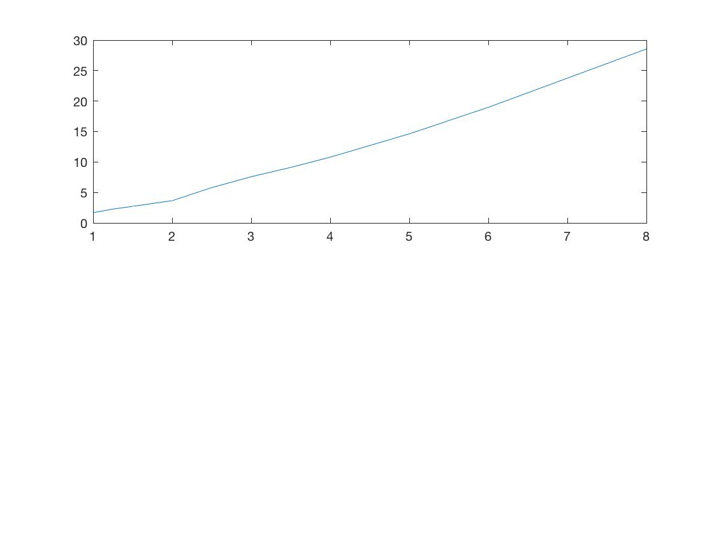
Sample Plot
Notes:
dia=[1,1.25,1.5,2,2.5,3,3.5,4,5,6,8];
mass=[1.68,2.27,2.72,3.65,5.79,7.58,9.11,10.79,14.62,18.97,28.55];

Slide 11
Add info to plots
x=[0, 1, 2, 3, 4, 5, 6 ,7 ,8]; %independent values
y=[0, 1, 4, 9, 16, 25 ,36 ,49 ,64]; %dependent values
plot(x,y) %plot y versus x
figure %now, create a new figure window
plot(x,y) %plot y versus x
grid %add grid lines
title('y = x^2’) %add graph title (note single quotes)
xlabel('x axis’) %add x-axis label (note single quotes)
ylabel('y axis') %add y-axis label (note single quotes)
Notes:
dia=[1,1.25,1.5,2,2.5,3,3.5,4,5,6,8];
mass=[1.68,2.27,2.72,3.65,5.79,7.58,9.11,10.79,14.62,18.97,28.55];

Slide 12
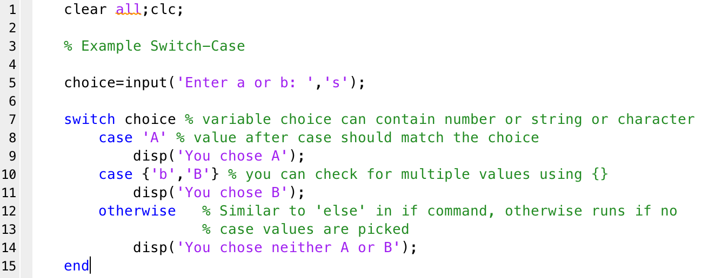
Switch-Case

Slide 13
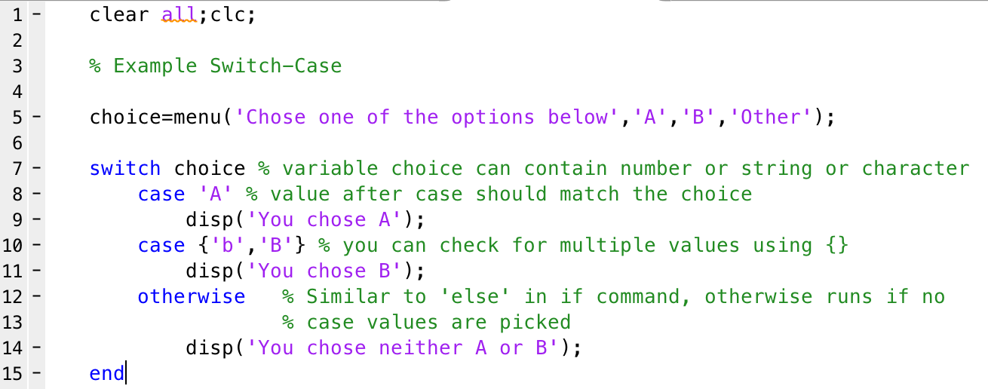
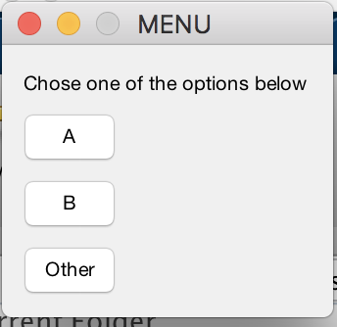
MENU Command
Syntax of menu command:
variable=menu(‘Title’, ‘Button Value#1’, ‘Button value#2’ …)
Variable will contain button number (1, 2, 3 …)
Notes:
Output will contain a number corresponding to the button = 1 thru number of buttons

Slide 14
How to plot multiples (overlay)
Option 1:
Simply supply the plot command with additional arguments, e.g.,
plot(x1,y1,x2,y2,…)
where x1,y1 and x2,y2 are pair of independent-dependent values that you wish to plot on the same graph
Option 2:
Use the hold command to hold current graph so that subsequent graphing commands add to the existing graph without resetting the color and line style
hold on to begin holding current figure, and hold off to stop.

Slide 15
Plot options
Example:
plot(x,y,‘s’)
Where ’s’ is a string containing at most 1 element from each column:
‘b*--’
Line color |  | Marker (symbol) style |  | line style
b | blue | . | point | - | solid
g | green | o | circle | : | dotted
r | red | x | x-mark | -. | dashdot
c | cyan | + | plus | -- | dashed
m | magenta | * | star | (none) | no line
y | yellow | s | square
k | black | d | diamond
w | white | v | triangle (down)
 |  | ^ | triangle (up)
 |  | < | triangle (left)
 |  | > | triangle (right)
 |  | p | pentagram
 |  | h | hexagram

Slide 16
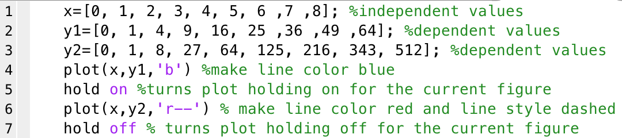
Sample Plot Code

Slide 17
Axis Scaling
When creating plots in MATLAB the axes are automatically scaled. Sometimes custom axis scaling is more desirable
The axis command, which has a large variety of options (type help axis for more information), allows the axis scaling to be changed following graph generation:
axis([x_min,x_max,y_min,y_max])
where x_min, x_max, y_min, and y_max represent the lower and upper limits on the x and y axes, respectively

Slide 18
Generating multiple plots
subplots
The subplot command allows a given figure window in MATLAB to be broken into a rectangular array of plots, each addressed with standard plot commands
The command subplot(m,n,p) or subplot(mnp) splits the figure window into an array of plots m-rows by n-columns, and addresses the pth subplot (the subplot index p counts from left to right beginning with the upper left plot and ending with the lower right plot)
NOTE
The subplot command does not plot data; it only creates axes in the figure window. You still need to use the plot command (or other commands that generate a plot), to graph data in a subplot

Slide 19
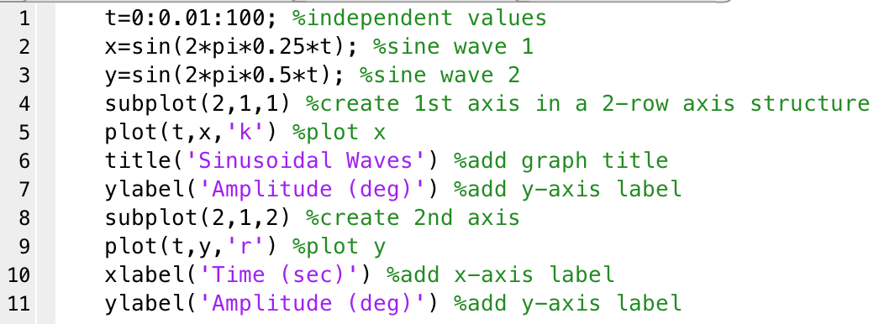
Sample Subplot code

Slide 20
Additional Plot commands
command | explanation
colordef | Set color default
whitebg | Change axes background color
text | Text annotation: text(x,y,‘text’) adds the text in the quotes to location (x,y) on the current axes
gtext | Place text with mouse: gtext(‘text’)
menu | Generate a menu of choices for user input. Best used with switch
inputdlg | Input dialog box
scatter | Scatter plot
Refer to textbook, section 4.13, for more details

Slide 21
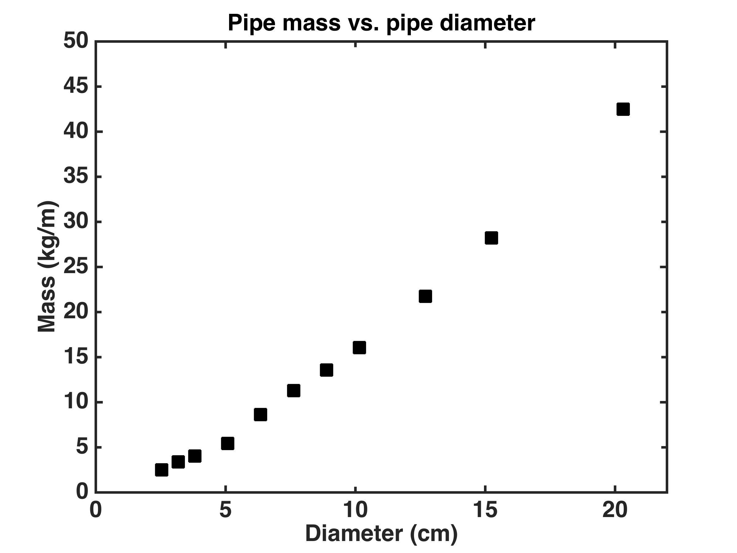
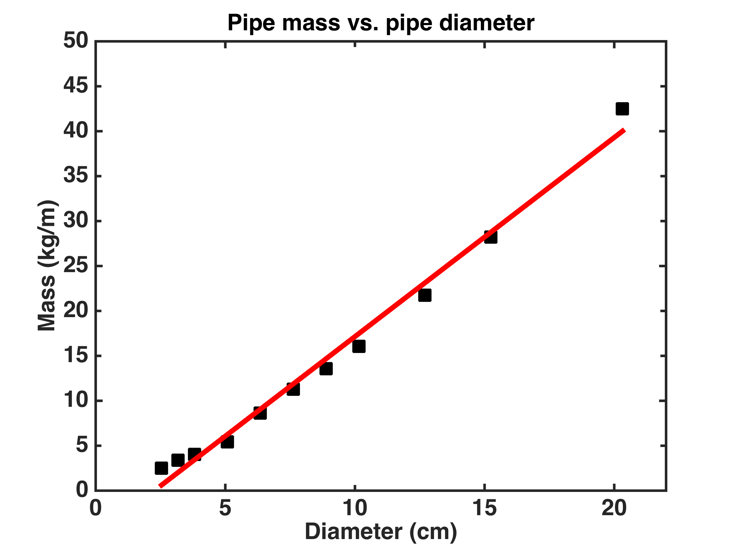
Linear regression
Given a set of data points i.e., pairs of (xi, yi), i = 1, 2, …, N, can we find an equation that describes the relationship between x and y?
Straight line:
f(xi)=a1xi+a0,

Slide 22
How can we derive the best-fit line?
Find a1 (i.e., the slope) and a0 (i.e., the intercept) of the straight line such that the difference between yi (measured pipe mass) and f(xi)=a1xi+a0 (predicted or estimated pipe mass) is small
This approach for finding the line is called the method of least squares
The resulting line is called the least-squares line or the regression line
(xi, yi)
y
(xi, yi)
(xi, yi)
(xi, a1xi+a0)
x
(xi, a1xi+a0)
(xi, a1xi+a0)
Notes:
This approach for finding the line is called the method of least squares
The resulting line is called the least-squares line or the regression line

Slide 23
How can Matlab derive the line?
Use polyfit command
coeff = polyfit(x,y,n)
polyfit finds the coeff (e.g., a1 and a0) of a polynomial f(x) of degree n that fits the data y via least squares method; x and y are data pairs, and n represents polynomial degree.
coeff = polyfit(x,y,1)
Polynomial :
f(x)=anx^{n}+an-1x^{n-1}+…+a2x²+a1x¹+a0x⁰, where x⁰=1, an: are the polynomial coefficients, and n: polynomial degree (value of the highest exponent is the degree of the polynomial).
For example, linear: f(x)=a1x+a0, quadratic: f(x)=a2x²+a1x+a0, cubic: f(x)=a3x³+a2x²+a1x+a0

Slide 24
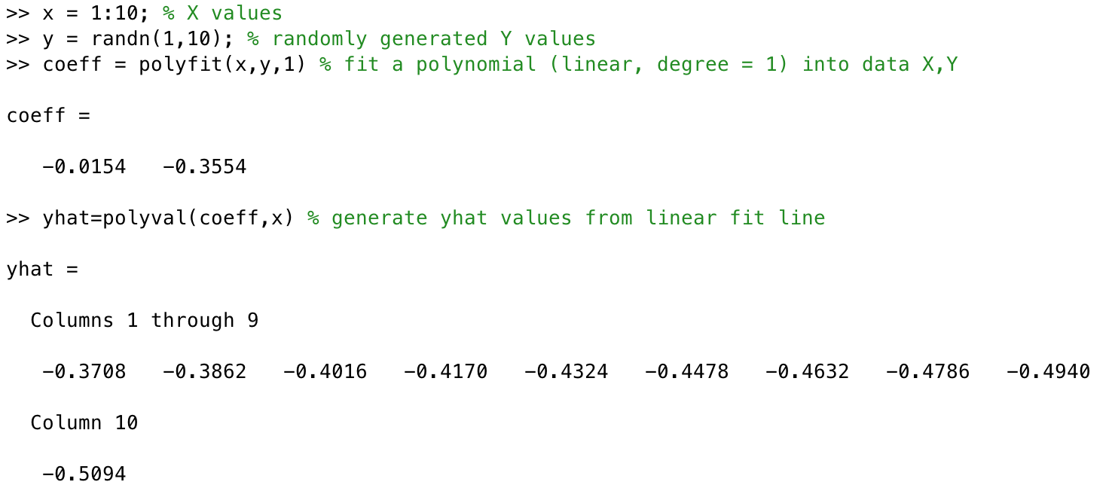
How can we calculate f(X)
Use polyval command to determine values if yHat=f(x)
Note: yHat is used instead of y to distinguish between the two data sets
Notes:
If x is an array, polyval calculates yhat for each element of the array and stores it in a new yhat array. In example above, x is an array (1:10);
To calculate yhat at a single value, simply replace x with the value. E.g. yhat=polyval(coeff, 12);

Slide 25
Error Analysis
Least square analysis or regression produces an approximate solution—even if the curve visually fits well there may exist several errors (deviations from raw data).
Goal of error analysis is to find the largest error
Absolute error
abs(y-yHat)
abs: MATLAB function/command to return absolute value
yHat: predicted (calculated) value
y: measured value
Note that this calculation does not give an indication of how serious the error is
RELATIVE ERROR
abs((y-yHat)./y)
Note that this way you get a feeling for the relative magnitude of the errors

Slide 26
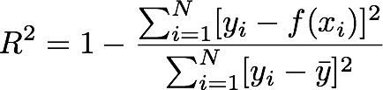
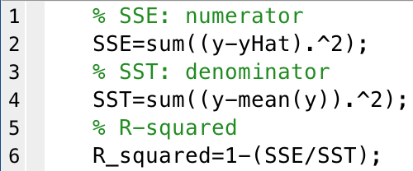
R-square
Standard error associated with linear regression:
In MATLAB:
sum of squares of errors (SSE)
total sum of squares (SST)
mean

Slide 27
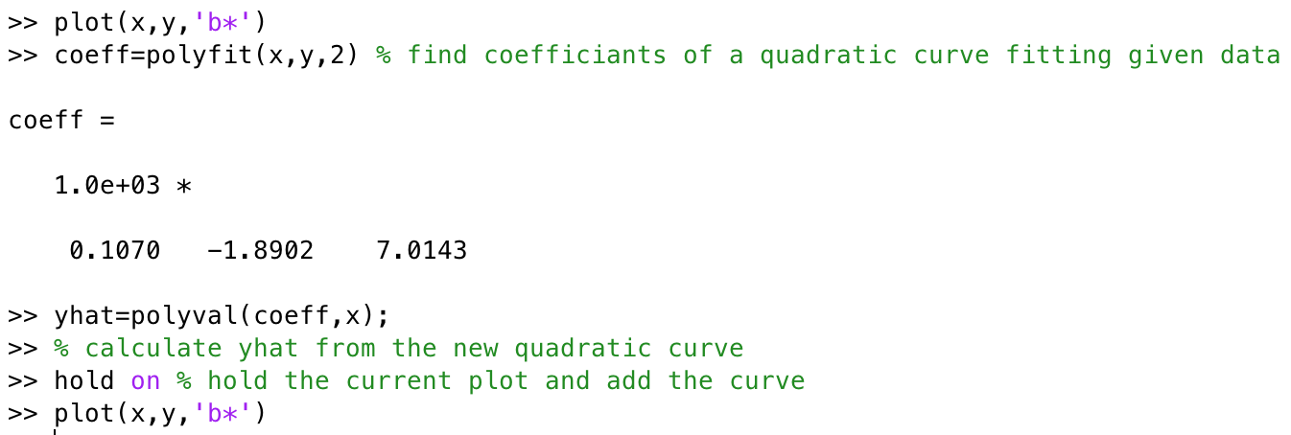
Polynomial curve fit
If x and y data pair, does not fall on a straight line, how can we find a curve that does fit the data?
Use polyfit with n>1
Notes:
Check out the next slide for the plots

Slide 28
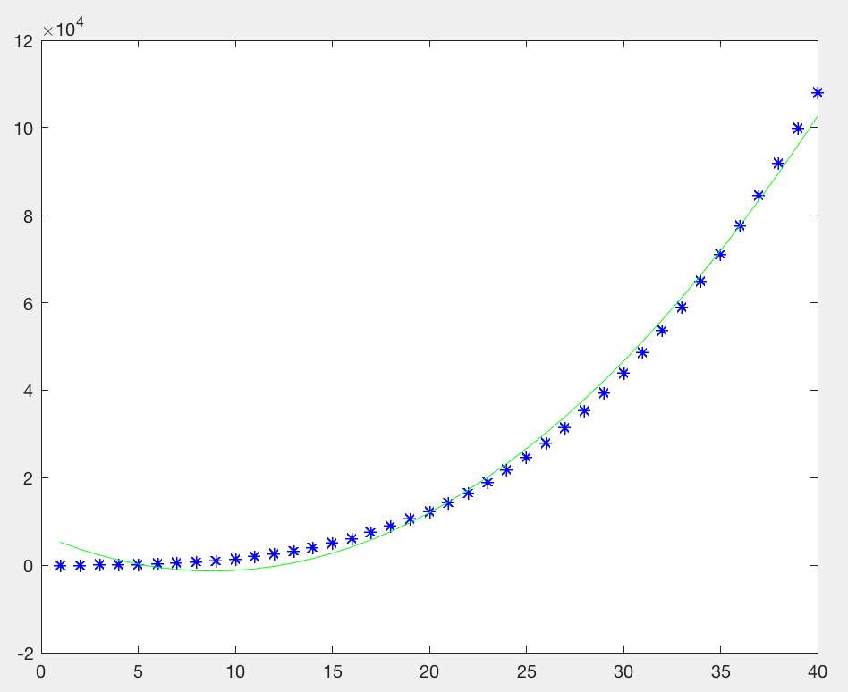
Polynomial curve fit
Notes:
Check the previous slides for information about this plot.

Slide 29
Acknowledgment
Based on handouts and lectures by Dr. Arash Mehboobin

